Slide 1
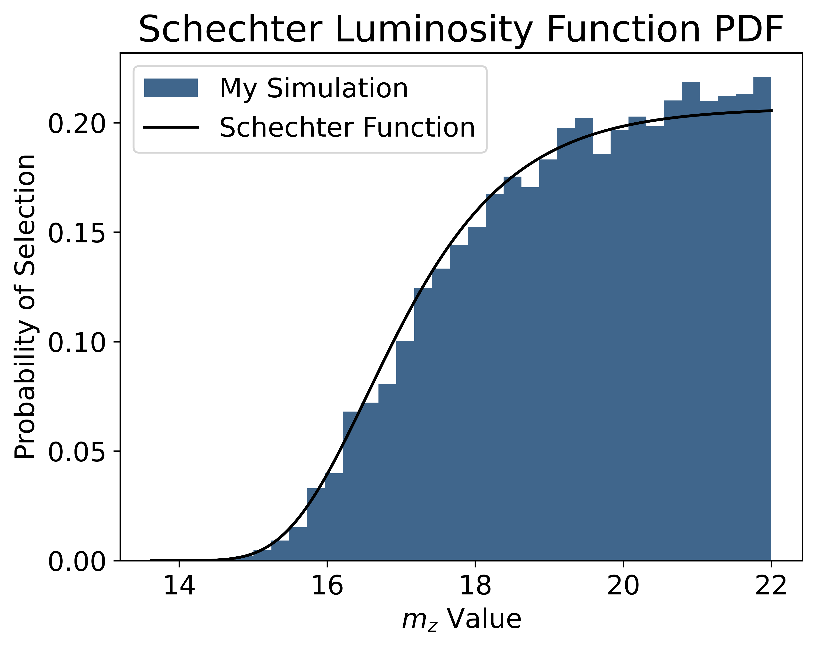
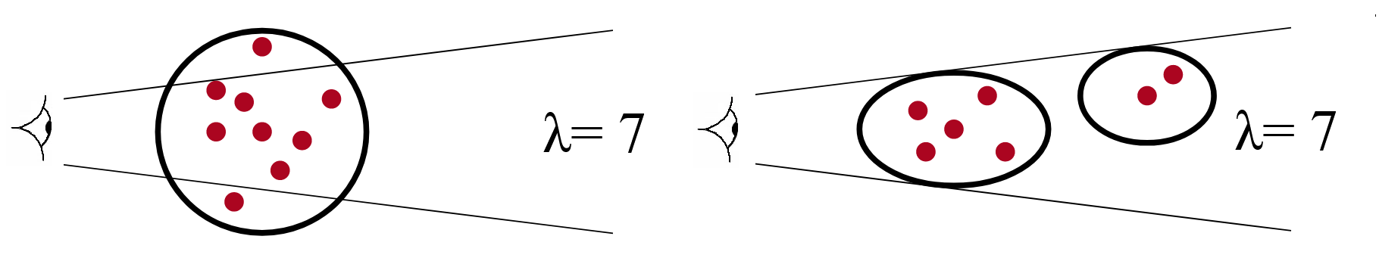
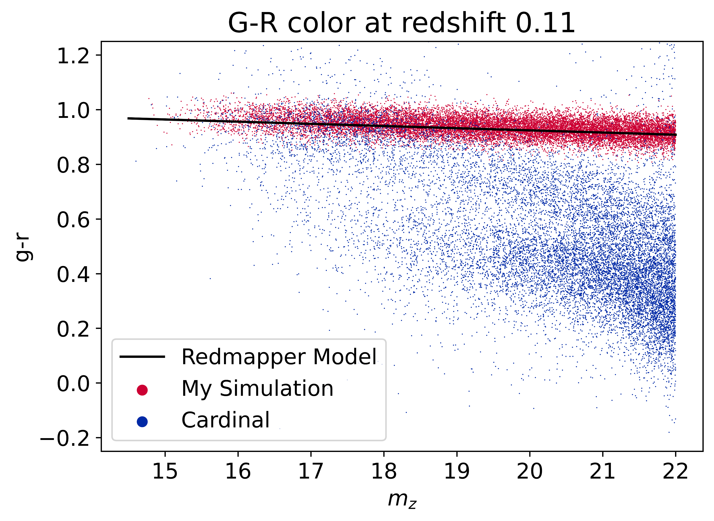
Creating A Fast Galaxy Simulation For Cosmological Inference
Keenan Fiedler ▲ Dr. Eduardo Rozo ▲ Dr. Andres Salcedo
Summary
The Problem
Validation and Next Steps
Galaxy clusters are the most sensitive tool for probing cosmology. The largest cluster catalogs for the foreseeable future will be photometrically selected from astronomical surveys like the Dark Energy Survey(DES) and the Legacy Survey of Space and Time(LSST).
However, photometric selection is subject to severe selection effects that compromise the accuracy of the resulting cluster catalogs.
Recent work has shown that these selection effects can be modeled by populating halos in dark matter simulations with galaxies. However, this is only an approximation since all the galaxies in the simulations lack magnitude and color information.
We have developed a new galaxy population framework to enable full modeling of photometric cluster selection in simulated catalogs.
We will use these new datasets to extend simulation-based inference analyses of galaxy cluster data.
Photometric galaxy surveys are prone to severe selection effects including projection effects, which are caused by the projecting a 3D space onto a 2D plane, which occurs when observing with telescopes.
Dr. Andres Salcedo modeled this effect by placing cylinders into a galaxy simulation and counting all galaxies within the cylinder as a part of a cluster.
This is an approximation that does not account for galaxy magnitudes and colors.
What is needed is a way to populate simulations with galaxies in a way that allows us to run the same cluster finders that are run on actual survey data.
Now that our simulation is complete, we need to validate the accuracy of my simulation.
To do this, we will take the Cardinal Catalog and fin the parameters it used and recreate it with our simulation. Then, we will verify that properties of the galaxy clusters in both simulations match.
Once this is done, we can generate large numbers of fast simulations that cover a broad parameter space to enable future simulation-based inference efforts.
We will also improve the accuracy of Dr. Andres Salcedo’s projection effects model.
This figure shows the effect of projection on galaxy cluster modeling. Projection effects can cause an observer to underestimate(left) or underestimate(right) the number of galaxies in a cluster.
Simulating Cluster Selection
To be able to run cluster finders on simulated data sets, every galaxy needs to be assigned a magnitude and color vector.
To determine the color vector of a galaxy, we need a model for the color distribution of galaxies over a large redshift range and all magnitudes.
To determine the magnitude of a galaxy, we use the Schechter luminosity function to assign galaxies a z-band magnitude based on their redshift.
RedMaPPer, a galaxy cluster finder, produces a color distribution model for red-sequence galaxies from a given input catalog, in this case Cardinal. Cardinal is a catalog of galaxies with highly accurate colors.
We can now assign a galaxy a color based on the redshift and z-band magnitude of the galaxy.
My simulation is essentially complete and accurately creates a galaxy catalog with matching colors to the Cardinal red-sequence.
This figure shows the analytical Schechter Luminosity Function(black) and a histogram of our simulation’s galaxy magnitudes(blue) in magnitude space. This is at a redshift of 0.11.
Acknowledgements and References
Many thanks to Dr. Eduardo Rozo and Dr. Andres Salcedo for providing advice and direction on this project. Thanks to TIMESTEP for organizing this poster presentation and for supporting my research.
Rykoff et. al. (2014) ApJ. 785.104
To et. al. (2024) ApJ. 961.59
Salcedo et. al. (2023) arXiv.2310.03944
This figure shows our simulation(red) and the Cardinal simulation(blue) at a certain redshift. The x-axis is galaxy magnitude in z-band, and the y-axis is the g-r color. The black line is the RedMaPPer model of the galaxy colors.

